Slide 1
Micro Array Analysis & Machine Learning on Leukemia T ALL VS. B ALL
Jiaqi Xiang, Xuanjie(Gavin) Gao
BMES 543 | SP21-22 | Instructor: Dr. Ahmet Sacan
06/07/2022

Slide 2
Leukemia[1]
Leukemia is a cancer that targets blood forming tissue of human body
Blood forming tissue – Bone marrow and lymphatic system
There are many different types of leukemia:
Acute lymphocytic leukemia(ALL)
More common in children, can also observed in adult
Acute myelogenous leukemia (AML)
Observed in both children and adult
Chronic lymphocytic leukemia (CLL)
More common in adult, progress slowly
Chronic myelogenous leukemia (CML)
More common in adult
Other

Slide 3
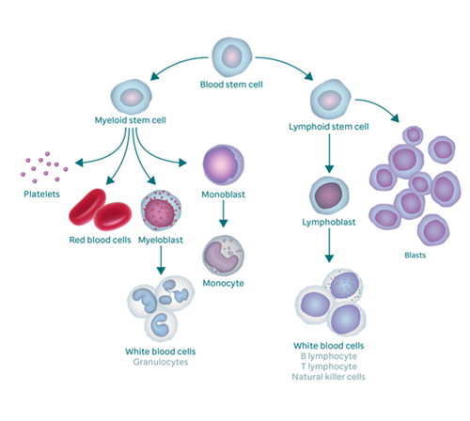
Acute lymphocytic leukemia
Acute lymphocytic leukemia(ALL) progress quickly and it targets lymphocytes in white blood cells.[2]
Affected patient will have excess number of blasts, which will affect normal white blood cells, red blood cells and platelets.[2]
If it occurs in children and patient received proper care, chance of cure is relatively high(85%-90%), compared to the chance of cure when ALL occurs in adult(40%-50%).[3]
Image credit: https://together.stjude.org/en-us/about-pediatric-cancer/types/leukemia/acute-lymphoblastic-leukemia-all.html

Slide 4
ALL: B-cell
B-cell acute lymphocytic leukemia(B ALL)[5]
Approximately 4000 children were diagnosed with ALL per year, 80% of them are B ALL
In normal situation, B cells differentiated from common lymphoid progenitor cells
While patient is diagnosed with B ALL, lymphoid differentiation is inhibited by uncontrolled growth of B precursor-stage lymphoid cells
The inhibition of lymphoid differentiation eventually causing abnormal cell proliferation and affecting the survival of cells.
Key factors:
TEL-AML1 fusion gene – molecular lesion initiate disease
BCR-ABL1 tyrosine kinase gene – most common mutation in B ALL
PAX5 paired box protein – control B cell development
RAS pathway – activation can negatively impact chemotherapy efficiency
PI3K/Akt pathway – Observed in many tumor cells, can eventually lead to relapse and failure of treatment

Slide 5
ALL: T-cell
T-cell acute lymphocytic leukemia(T ALL)[6]
T ALL is about 15%-20% of all children ALL cases, and about 25% of all adult ALL cases
Cure rate for children is about 75%, for adult it is about 50%
Malignant transformation of T cell progenitors eventually leads to occurrence of T ALL
Translocation, aberrant expression of transcription factor oncogenes were observed in most T ALL cases
Key factors:
NOTCH 1 signaling pathway – most important pathway in T cell transformation
INK4A & ARF suppressor gene – deletion of those genes were observed in more than 70% of T ALL cases
Basic helix-loop-helix family, LIM-only domain genes, HOXA homeobox genes – oncogenic transcription factors

Slide 6
Goal
To identify differently expressed gene in between T ALL and B ALL

Slide 7
Datasets
GSE 13425
Intro
GSE 13351
Intro

Slide 8
Methods involved
T-test
Fold change
Clustergram
Cross-validation with fold change
Feature selection

Slide 9
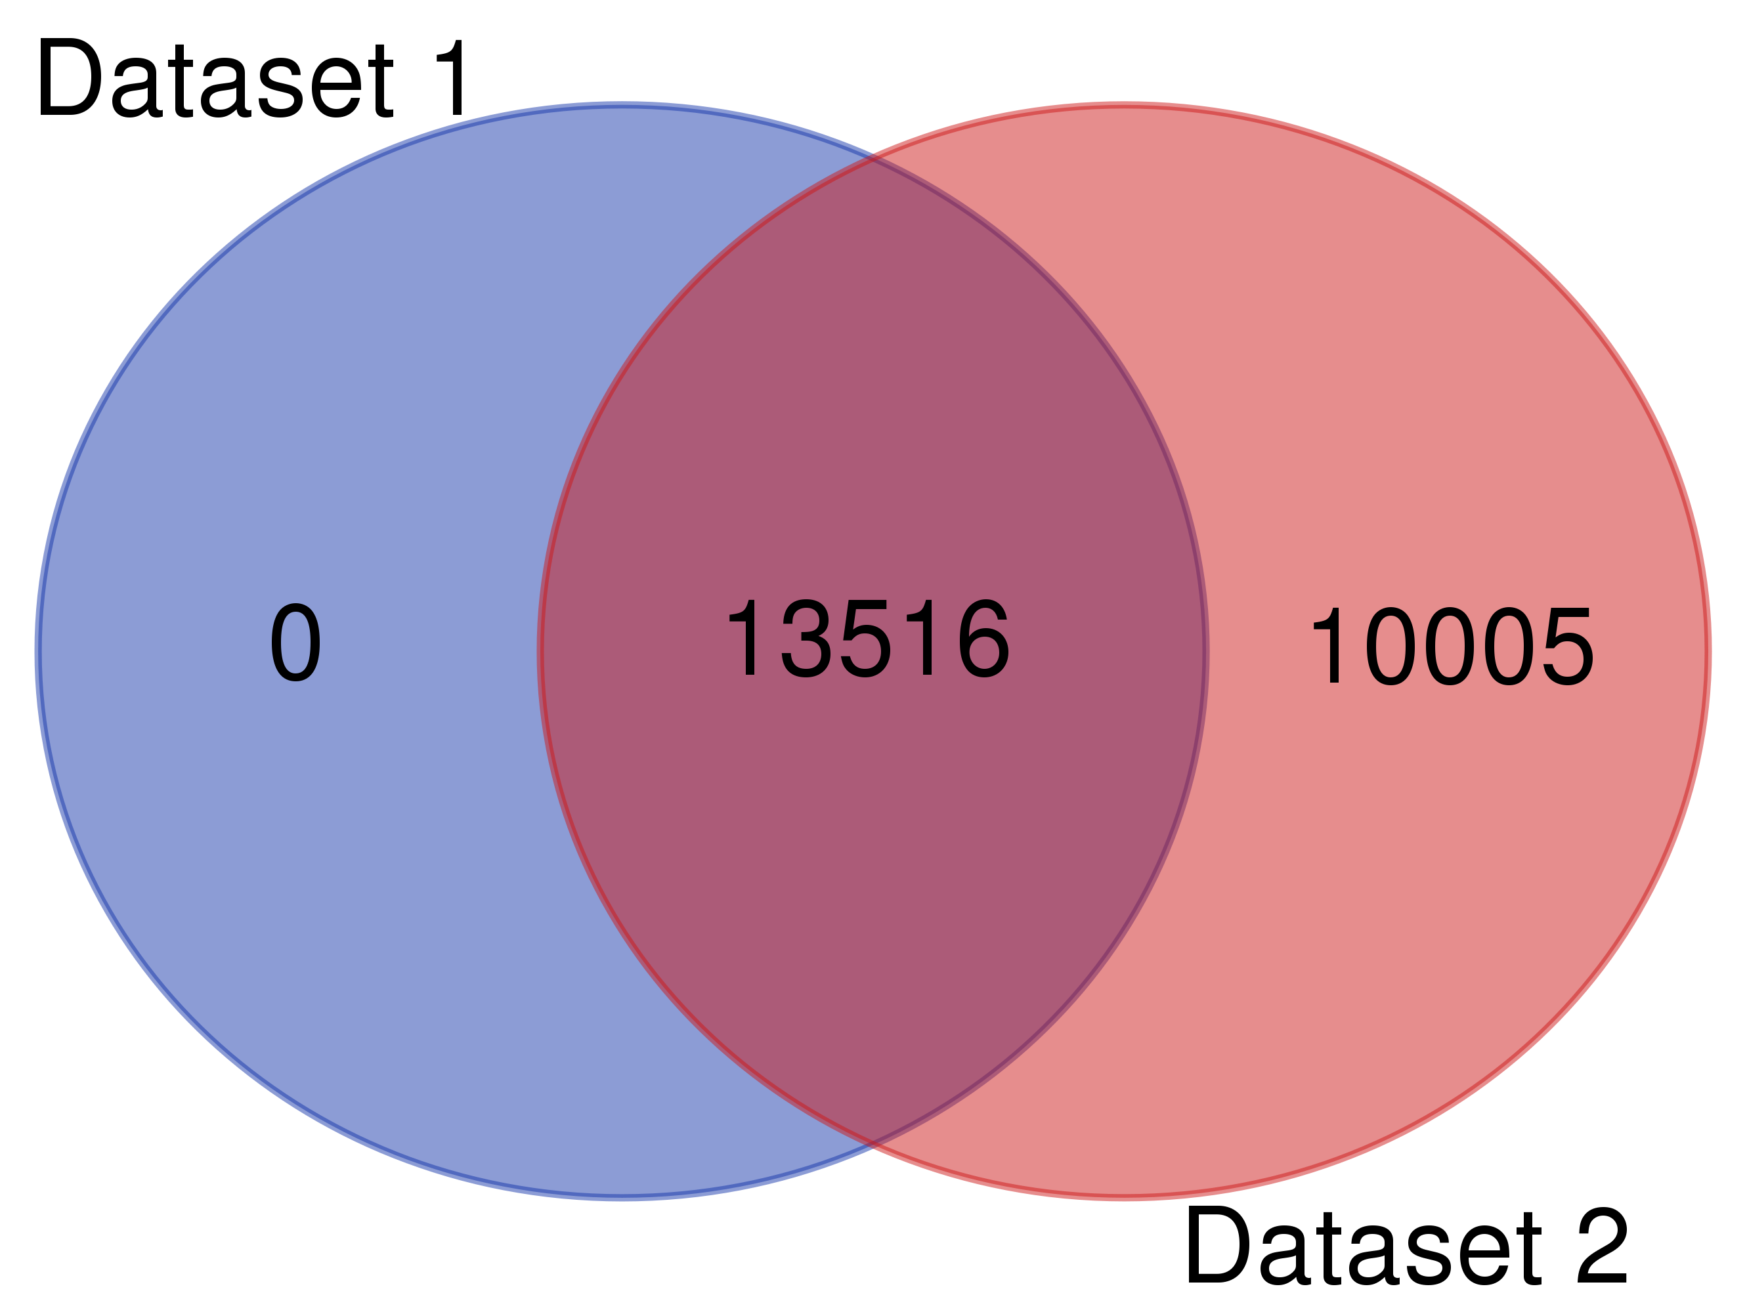
Results
Intersection genes

Slide 10
Results

Slide 11
Discussion
Does results make sense?(update)
Limitation of this study
Only studied T-ALL vs. B-ALL, B-ALL is the most common type, and it contains couple of sub-types
Following studies

Slide 12
References
[1] Mayo Clinic Staff, (2021, Jan 13), Leukemia, Mayo Clinic, https://www.mayoclinic.org/diseases-conditions/leukemia/symptoms-causes/syc-20374373#:~:text=Leukemia%20is%20cancer%20of%20the,involves%20the%20white%20blood%20cells.
[2] Mayo Clinic Staff, (2021, Feb 10), Acute lymphocytic leukemia, Mayo Clinic, https://www.mayoclinic.org/diseases-conditions/acute-lymphocytic-leukemia/symptoms-causes/syc-20369077#:~:text=Acute%20lymphocytic%20leukemia%20(ALL)%20is,cells%2C%20rather%20than%20mature%20ones.
[3] St.Jude Children’s Research Hospital, (2020, Feb), Acute lymphocytic leukemia(ALL), from: https://together.stjude.org/en-us/about-pediatric-cancer/types/leukemia/acute-lymphoblastic-leukemia-all.html
[4] Onciu. (2009). Acute Lymphoblastic Leukemia. Hematology/oncology Clinics of North America, 23(4), 655–674. https://doi.org/10.1016/j.hoc.2009.04.009
[5] Huang, Liao, E., Li, C., Yen, C., & Yu, S. (2020). Pathogenesis of pediatric B‑cell acute lymphoblastic leukemia: Molecular pathways and disease treatments (Review). Oncology Letters, 20(1), 448–454. https://doi.org/10.3892/ol.2020.11583
[6] Van Vlierberghe, & Ferrando, A. (2012). The molecular basis of T cell acute lymphoblastic leukemia. The Journal of Clinical Investigation, 122(10), 3398–3406. https://doi.org/10.1172/JCI61269

